Slide 1

Amazon Product Reviews Sentiment Analysis with NLP

Slide 2
CONTENTS:
Aim of Project
Datasets
Data Preprocessing
Model Training and Evaluation
Model Selection
Evaluation and Validation
Evaluation Metrics
Results and Future Works

Slide 3
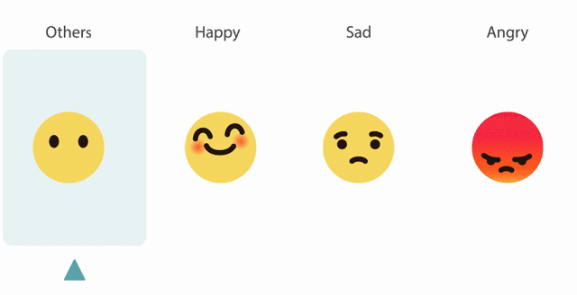
Aim of Our Project
The main goal of our project is to analyze data from Amazon reviews and uncover customer perceptions, metrics, and overall warmth levels regarding Alexa products through the insights gained from these analyses.
For this purpose, emotional analysis will be carried out using natural language processing (NLP) techniques and machine processing models. These analyzes aim to provide more comprehensive details of customer experiences and make valuable contributions to expanding product development.

Slide 4
What is NLP and Sentiment Analysis
Natural Language Processing (NLP) is a field of artificial intelligence that focuses on enabling computers to understand, interpret, and generate human language. It utilizes grammar rules, statistical methods, and machine learning techniques to achieve this.
Sentiment Analysis is a subset of Natural Language Processing (NLP) that focuses on identifying and categorizing opinions expressed in a piece of text. It involves determining whether the sentiment or emotion behind the text is positive, negative, or neutral.

Slide 5
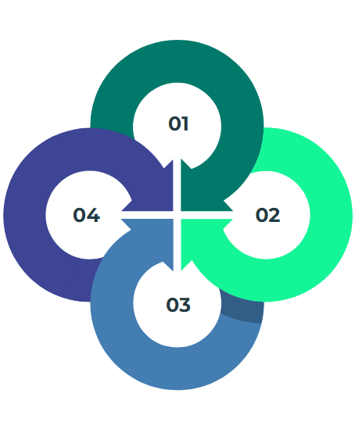
Data Collection
Finding Amazon product reviews on Kaggle
Handling missing values
Cleaning and normalization
Preprocessing the collected data

Slide 6
Dataset

Slide 7
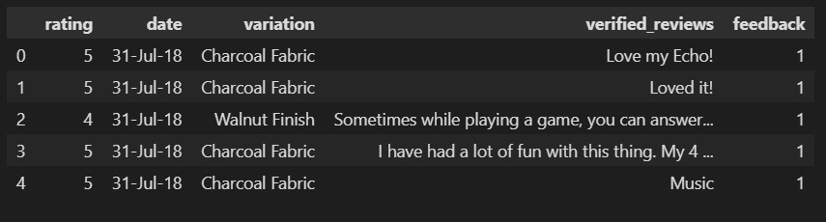

The dataset from Kaggle:
3150 reviews
2893 (1=positive),
257 (0=negative) comment
16 product
39179 words
Rating : The rates that given to the product.
Date : The date that review was made.
Variation : The variation of the product.
Review Text : The comment that we will work on
Feedback : Show us the review is positive(1) or negative(0).

Slide 8
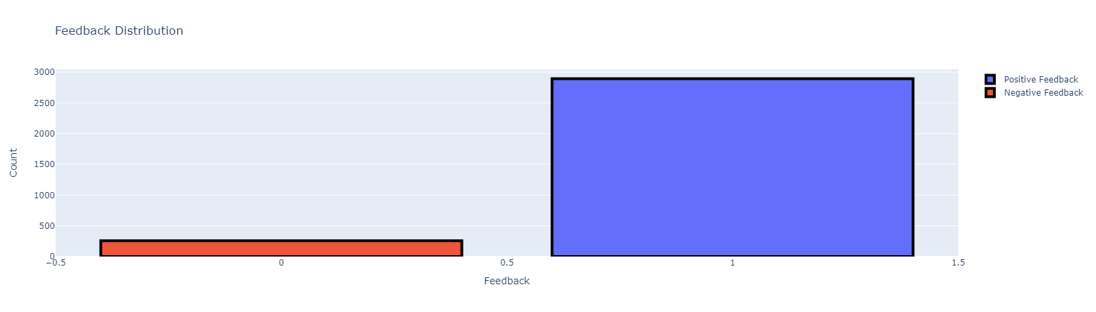
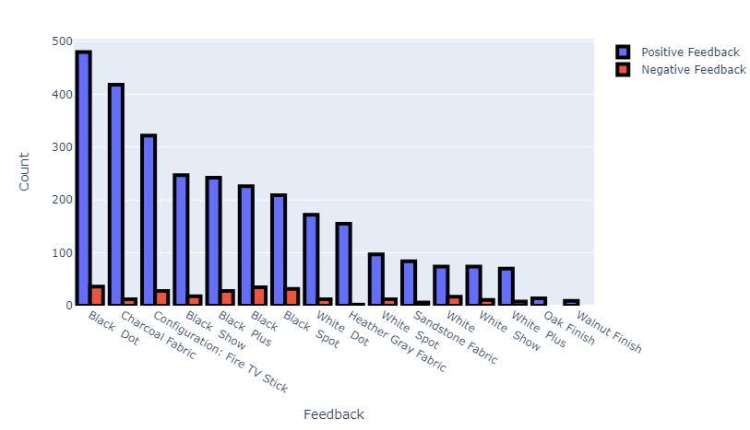
How many positive and negative comments were written on which product?

Slide 9
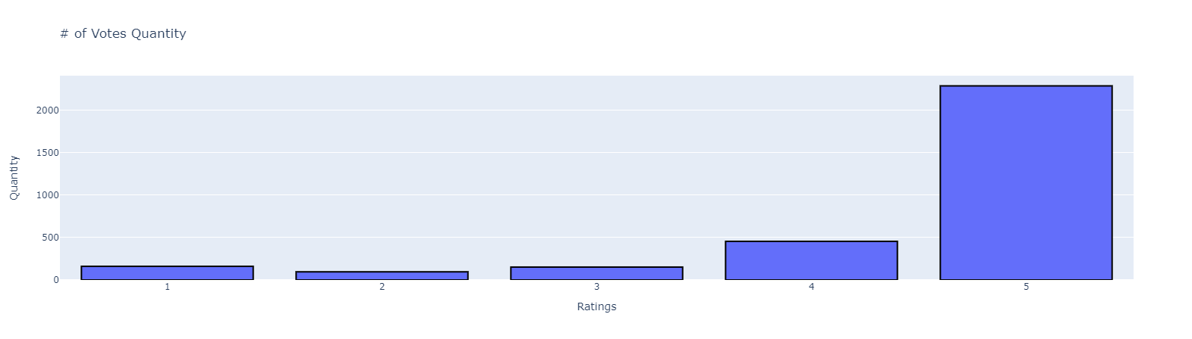
Distribution of votes

Slide 10
Data Preprocessing

Slide 11
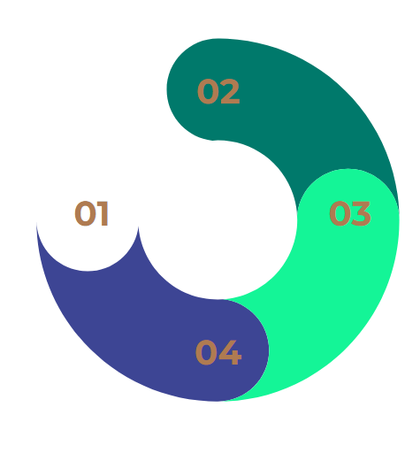
NLP Techniques
Tokenization
It helps identify positive or negative expressions.
Removing Stopwords
Commonly used but do not contribute to the analysis from the text.
Bag of Words(BoW) CountVectorizer
A method of representing text data with vectors, taking into account the frequency of words.
Stemming(PorterStemmer)
Reducing words to their root forms.

Slide 12
Data Preprocessing
Tokenization
I love the new Alexa device! It's incredibly helpful and easy to use. However, the setup process was a bit complicated.

Slide 13
Data Preprocessing
Tokenization
['I', 'love', 'the', 'new', 'Alexa', 'device', '!', 'It', "'s", 'incredibly', 'helpful', 'and', 'easy', 'to', 'use', '.', 'However', ',', 'the', 'setup', 'process', 'was', 'a', 'bit', 'complicated', '.']

Slide 14
Data Preprocessing
Removing stopwords
I love the new alexa device! it's incredibly helpful and easy to use. however, the setup process was a bit complicated.

Slide 15
Data Preprocessing
Removing stopwords
I love the new alexa device! it's incredibly helpful and easy to use. however, the setup process was a bit complicated.

Slide 16
Data Preprocessing
Removing stopwords
love new alexa device! incredibly helpful easy use. however, setup process bit complicated.

Slide 17
Data Preprocessing
Stemming(PorterStemmer)
I love the new Alexa device! It's incredibly helpful and easy to use. However, the setup process was a bit complicated.

Slide 18
Data Preprocessing
Stemming(PorterStemmer)
"device" -> "devic"
"incredibly" -> "incred"
"helpful" -> "help"
"easy" -> "easi"
"however" -> "howev"
"complicated" -> "complic"
I love the new alexa devic ! it's incred help and easi to use . howev , the setup process wa a bit complic .

Slide 19

Data Preprocessing
BoW Model (CountVectorizer)
{
'love': 1,
'new': 1,
'alexa': 1,
'devic': 1,
'incred': 1,
'help': 1,
'easi': 1,
'use': 1,
'howev': 1,
'setup': 1,
'process': 1,
'bit': 1,
'complic': 1
}

Slide 20
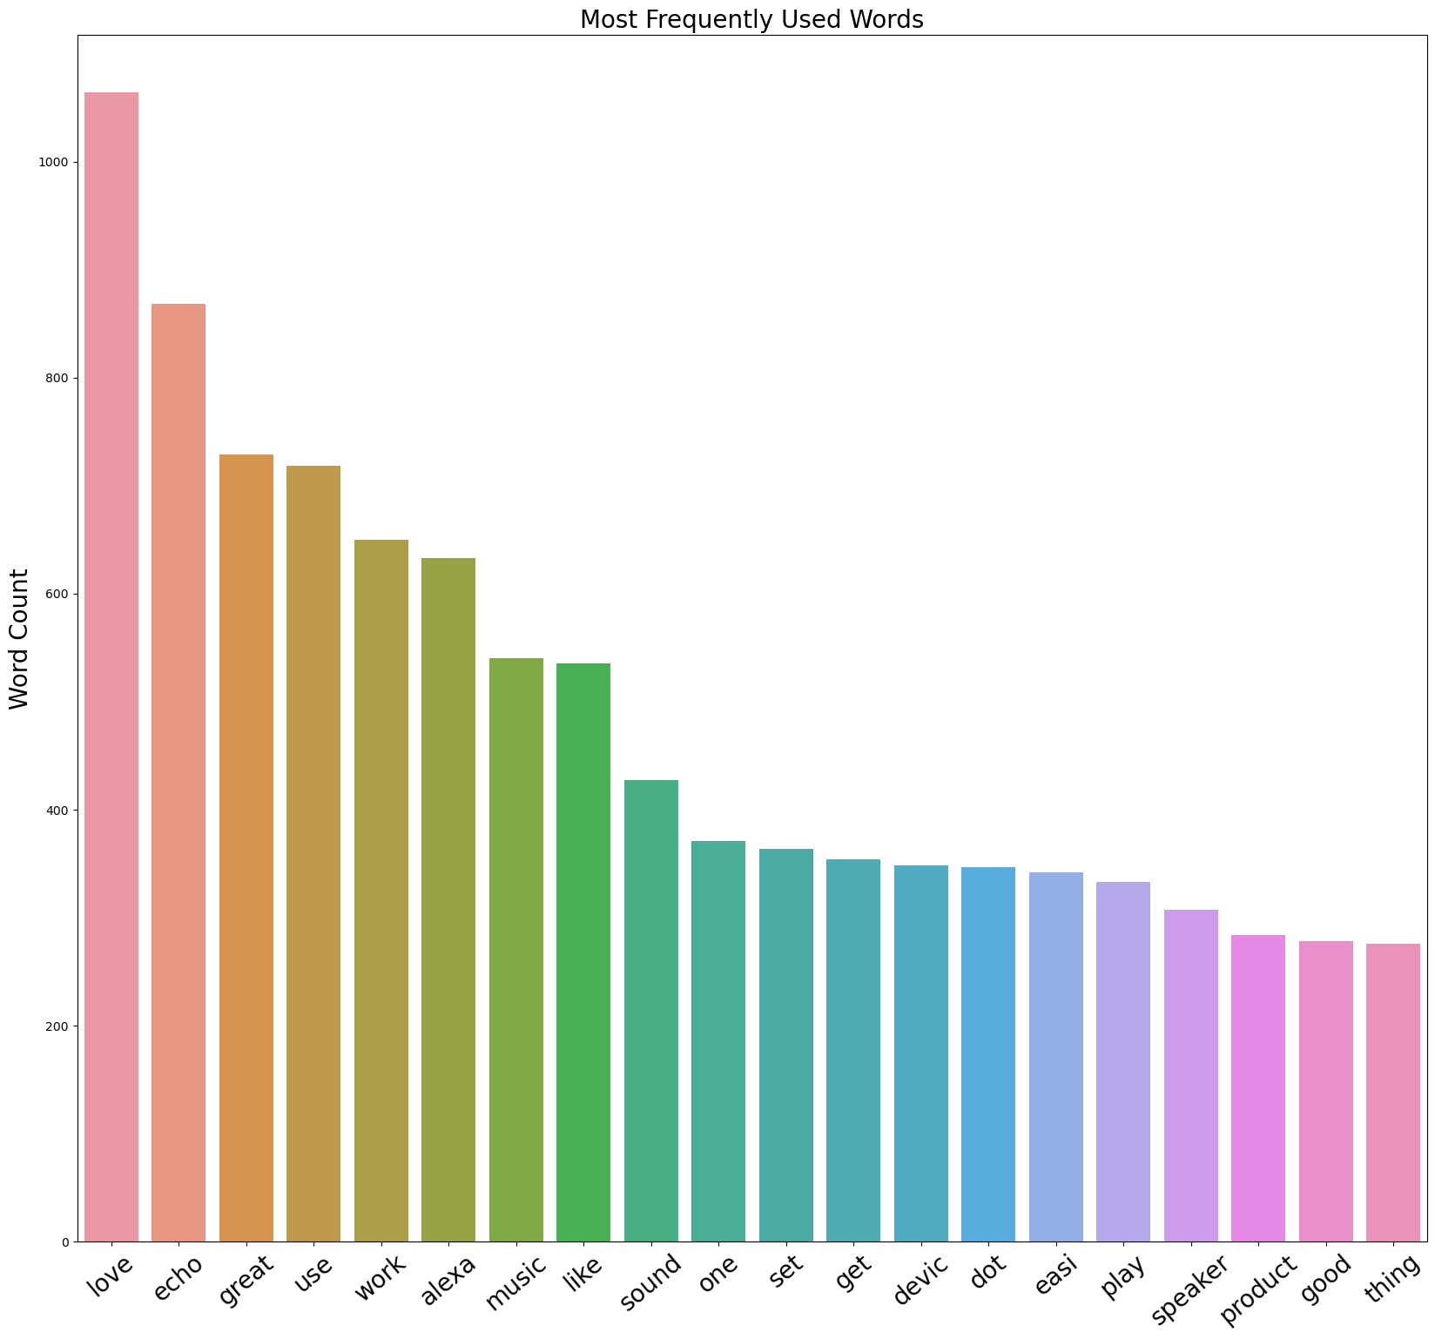

Slide 21
Model Training and Evaluation

Slide 22
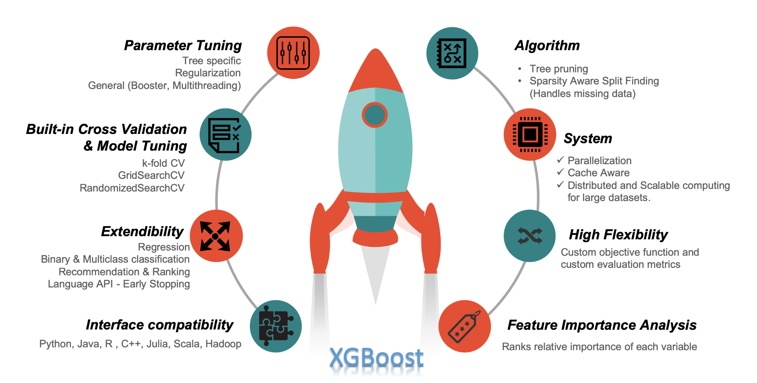
XGBoost Classifier
XGBoost (Extreme Gradient Boosting) is a popular and powerful machine learning algorithm used for both classification and regression tasks.
It belongs to the ensemble learning methods, specifically boosting, which combines multiple weak learners (typically decision trees) sequentially to create a strong learner.
XGBoost is a gradient boosting algorithm in which decision trees are trained sequentially.
Gradient Boosting: Each tree is optimized to fix bugs of previous trees.

Slide 23
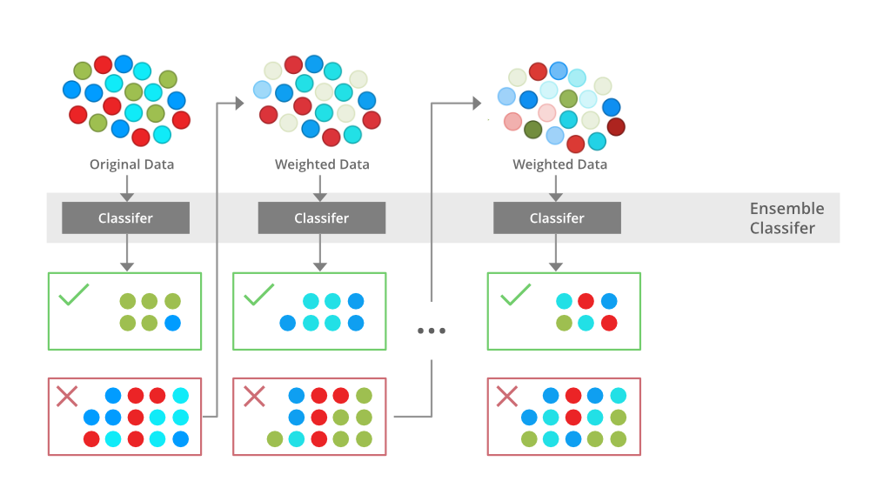
Harnessing XGBoost for Sentiment Analysis in Amazon Reviews
Preparation: Clean up reviews, removing unnecessary words and breaking them into understandable pieces.
Turning Words into Numbers: Convert words into numbers using techniques like word counting or unique representation.
Training the Model: Teach XGBoost to recognize positive or negative sentiment by feeding it labeled reviews.
Testing: Evaluate the model's performance by testing it with new, unseen reviews.
Using it for Amazon Reviews: Apply the trained XGBoost model to analyze new Amazon reviews and determine customer sentiment.

Slide 24
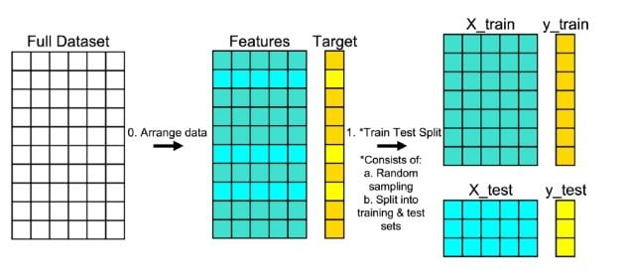
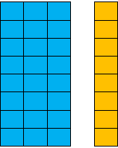

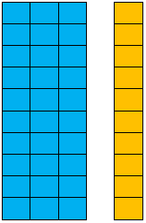
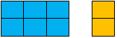
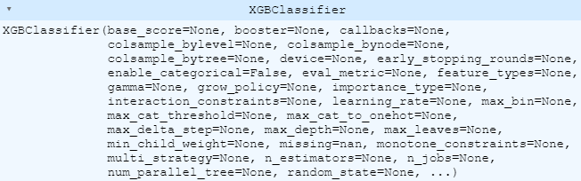
XGBoost Classifier
Features: Data to use when making modern predictions
Target: The output the model was trying to predict

Slide 25
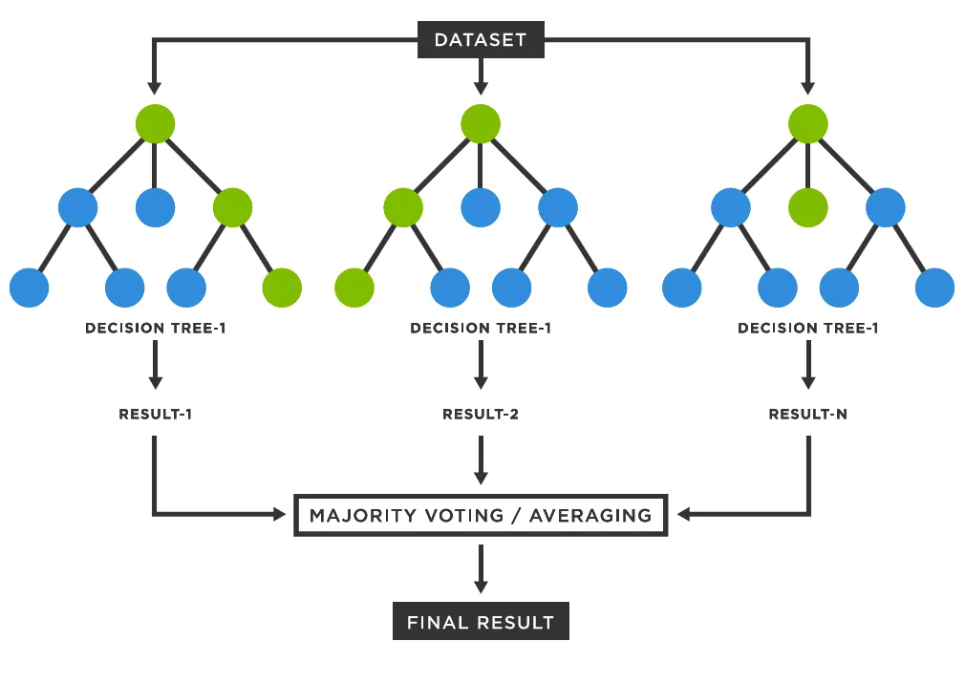
Alternative Model: Random Forest
Combines multiple decision trees.
Decisions are made by majority vote of the trees.
Provides protection against overfitting.
Offers high accuracy and robust performance.
Used for classification and regression.
Random Forest build independent decision trees and combine them in parallel.

Slide 26
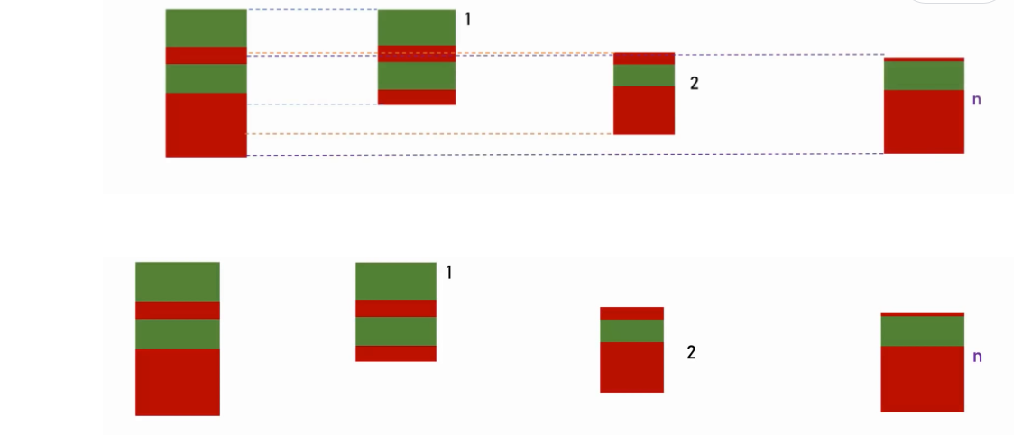
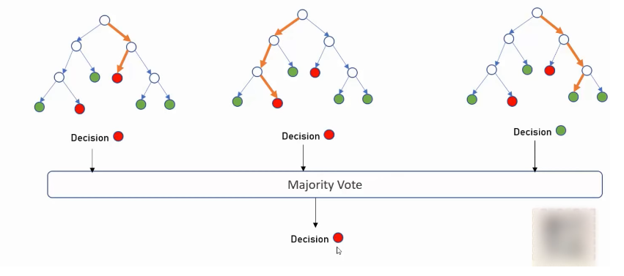
Data Preparation
Amazon Reviews: A large dataset of reviews.
Feature Extraction: Extract features like word count and count of positive/negative words.
Creating Decision Trees
Split Reviews into Small Groups: Divide reviews into smaller groups for easier processing.
Train Trees: Train individual decision trees for each group of reviews.
Making Decisions
Tree Evaluation: Each decision tree evaluates a review by asking specific questions.
Example: "Does the review contain the word 'excellent'?" -> If yes, consider it positive.
Example: "Is the review rated 1 star?" -> If yes, consider it negative.
Combining Decisions
Majority Vote: Gather decisions from all trees.
If 2 out of 3 trees classify a review as negative and 1 as positive, the final decision is negative.

Slide 27
Model Selection

Slide 28
Feature | Random Forest | XGBoost
Model Building | Ensemble learning using independently built decision trees. | Sequential ensemble learning with trees correcting errors of previous ones.
Optimization Approach | Makes predictions by averaging individual tree outputs. | Employs gradient boosting to minimize a loss function and improve accuracy iteratively.
Ease of Tuning | Simple and straightforward | Requires more practice but offers higher accuracy
Adaptability to Distributed Computing | Works well with multiple machines | Needs more coordination but can handle large datasets efficiently
Handling Large Datasets | Can handle them but may slow down with very large data | Built for speed, perfect for big datasets
Predictive Accuracy | Good, but not always the most precise | Superior accuracy, especially in tough situations
RANDOM FOREST vs XGBOOST

Slide 29
Evaluation Metrics Explanations
Accuracy: The percentage of correct predictions made by your model out of the total number of predictions.
Precision: Measures the percentage of predictions made by the model that are correct.
Recall: Recall measures the ability of a model to identify all relevant instances.
F1 Score: A metric that combines precision and recall to provide a balanced assessment

Slide 30
Evaluation Metrics Comparison
Accuracy: %85
Precision: %84
Recall: %83
F1 Score: %83
Accuracy: %87
Precision: %86
Recall: %85
F1 Score: %96.37
Comparison:
Accuracy: XGBoost outperformed in accuracy with a higher performance (87% compared to 85%).
Precision: XGBoost also yielded better results in precision (86% compared to 84%).
Recall: XGBoost exhibited higher performance in recall compared to Random Forest (85% versus 83%).
F1 Score: XGBoost showed superiority in F1 Score as well, outscoring Random Forest (86% versus 83%).

Slide 31
Results and Analysis

Slide 32
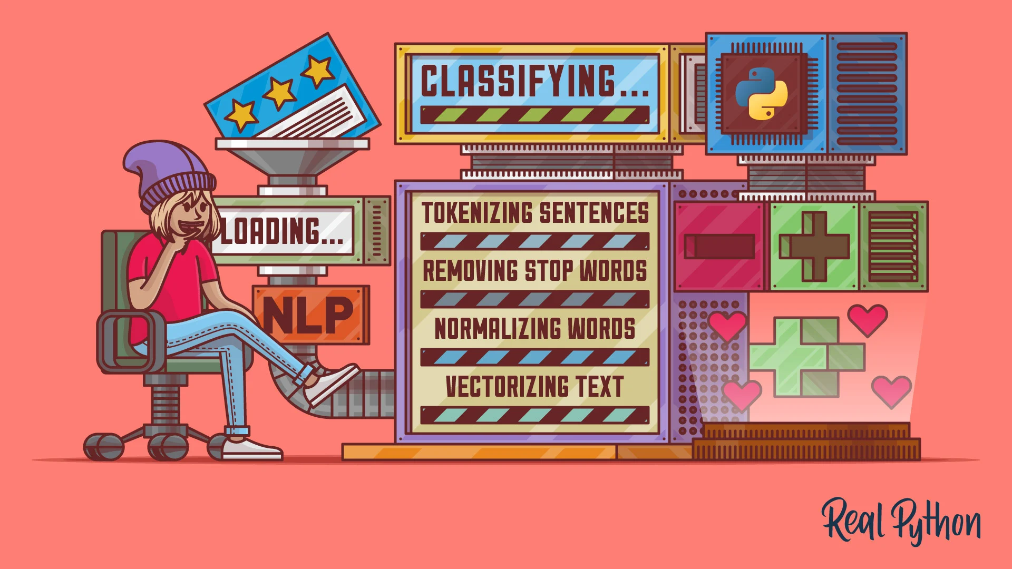
How We Used NLP
We applied NLP techniques including tokenization, stemming, stopword removal, and Bag of Words to process Amazon product reviews.
What We Aimed to Achieve
Our goal was to classify reviews as positive or negative and extract insights to understand customer sentiment and identify key issues.
How the Model Met Our Needs
The XGBoost model achieved high performance with 87% accuracy and a 96.37% F1 score, providing valuable insights into customer satisfaction and areas for improvement. Future work will address multilingual reviews, class imbalance, and advanced NLP techniques.

Slide 33
Summary
and
Future Work

Slide 34
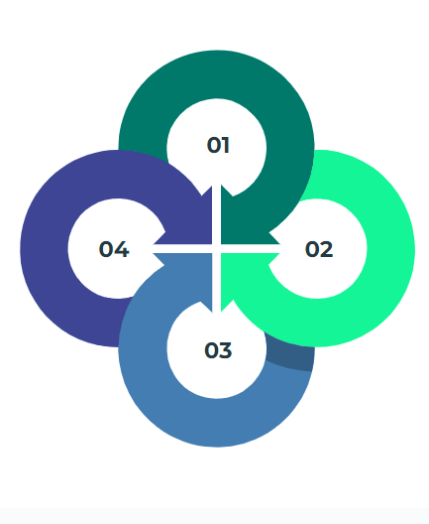
Challenges and Future Directions
Improving Model Generalization
Handling Multilingual Reviews
Exploring Other NLP Techniques
Dealing with Imbalanced Classes

Slide 35
Thank you for your time and attention 🙂
(21 07 06 041) Esma Şen
(21 07 06 015) Harun Yahya Ünal (21 07 06 039) Berke Ensel

